Slide 1
Dr. B R Ambedkar National Institute of Technology Jalandhar
Modelling and Simulation of Servo Controlled Antenna System
DEPARTMENT OF MECHANICAL ENGINEERING
Submitted By: Diyora Ujas Vinodkumar B.Tech (16109025)
Supervisor: Dr. Joseph Anand Vaz Professor

Slide 2
INTRODUCTION
The objective of the project is to develop a mathematical model of the servo control antenna ground station using the bond graph approach.

Slide 3
LITERATURE REVIEW
Research paper are studied to get the brief idea of antenna pointing mechanism, modelling the simulation.
The satellite’s antenna should be aligned with the satellite ground control station antenna to optimize the performance of a communication system.
(Rajini &amp; Murthy, 2015) In this paper they have presented a mathematical model of the antenna servo control system for remote sensing satellite ground station. They have analysed the system behaviour by using PID controller.
The response of the motor has been observed by giving different inputs to the system like step input, sinusoidal input, and parabolic input.

Slide 4
(Aloo, Kihato, &amp; Kamau, 2016) in this paper they have presented the hybrid PID-LQR Controller to get the more pointing accuracy. The model has been simulated in MATLAB/SIMULINK. the PID Controller and the hybrid PID-LQR Controller is compared in this paper and it is shown that the Hybrid PID-LQR Controller gives the better result.

Slide 5
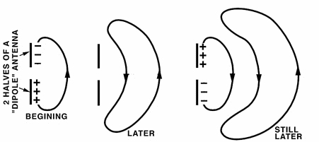
Antenna
A satellite dish is a dish-shaped type of parabolic antenna designed to receive or transmit information by radio waves from or to a communication satellite.

Slide 6
Figure : 7.5 m antenna system

Slide 7
Working of Antenna
Antenna can work as a Transmitter or as a Receiver.
As a Transmitter , it receives an Electric Signal and converts it into electromagnetic waves.
As a Receiver, It receives an Electromagnetic Waves and converts it into Voltage Signal.

Slide 8
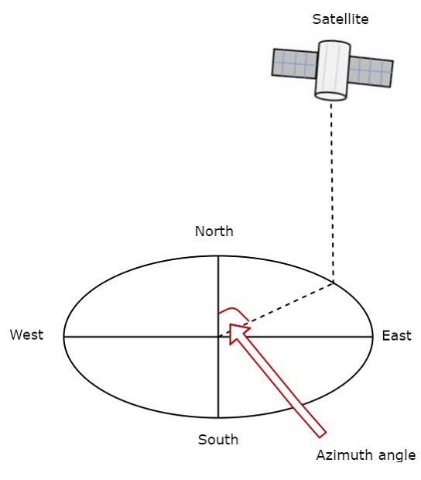
LOOK ANGLES
Azimuth Angle:
The angle between local horizontal plane and the plane passing through earth station, satellite and centre of earth is called as azimuth angle. Azimuth refers to the rotation around a vertical axis. Azimuth tells us what direction to face.

Slide 9
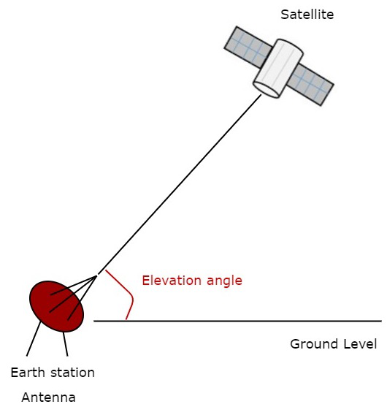
Elevation Angle :
Elevation angle is the angle between the line pointing direction towards the satellite and the horizontal plane. Elevation tells you how high up in the sky to look. It is also measured in degrees.

Slide 10
Bond Graph Methodology
Nowadays, Engineering Systems are becoming complex and for design purpose must be considered as multidisciplinary systems made up of components from different Engineering Disciplines.
Bond graph is methodology which is suitable for multidisciplinary systems.
In this system, first we derive equations from bond graph and plot it in form of block diagram in MATLAB Simulink

Slide 11
What is MATLAB SIMULINK
Simulink is a MATLAB based graphical programming environment for modelling, simulating and analyzing multidomain dynamical system.
It is basically a graphical block diagramming tool with customizable set of block libraries.
There are two major categories of elements in simulink: Blocks and Lines.
Blocks are used to generate, modify, combine, output, and display signals. Lines are used to transfer signals from output terminal of one block to input terminal of another block. This signal can be either a scalar signal or a vector signal.

Slide 12
BOND GRAPH MODELING AND SIMULATION
We are applying desired angular velocity as a input at two joints(one at Q1 and second at P1).
Desired angle
For 1st link is- 0 to 360 degree
For 2nd link is- -20 to 190 degree

Slide 14
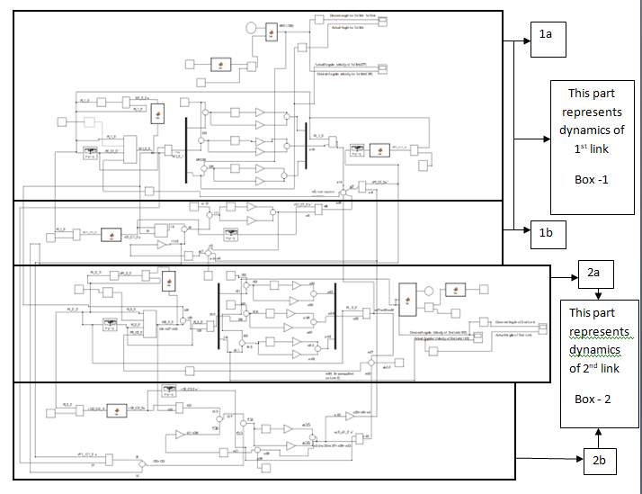
Simulink Model of Two Link

Slide 15
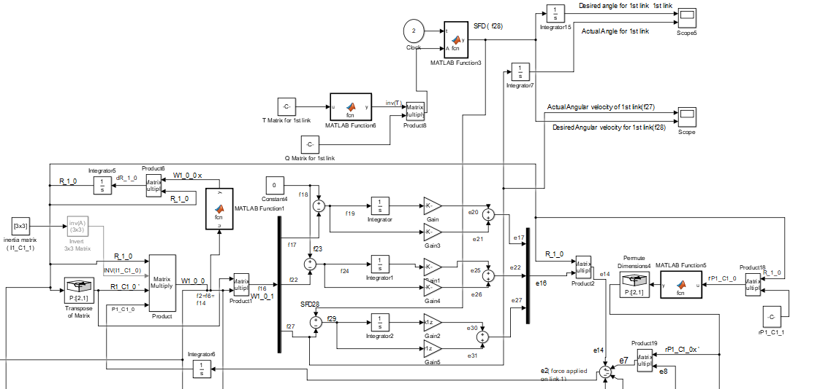
Block 1a- which represents rotational motion of link 1

Slide 16
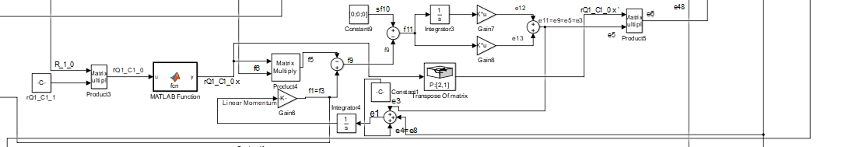
Block 1b- which represents translational motion of link 1

Slide 17
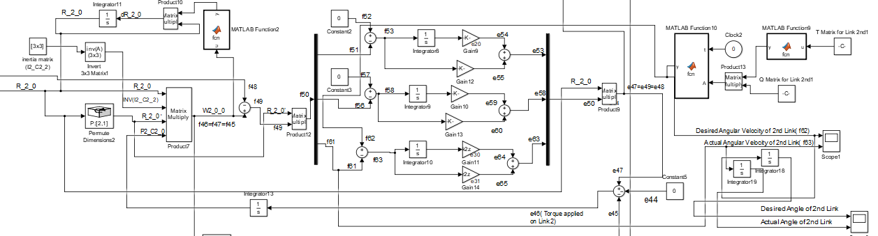
Block 2a- which represents rotational motion of link 2

Slide 18
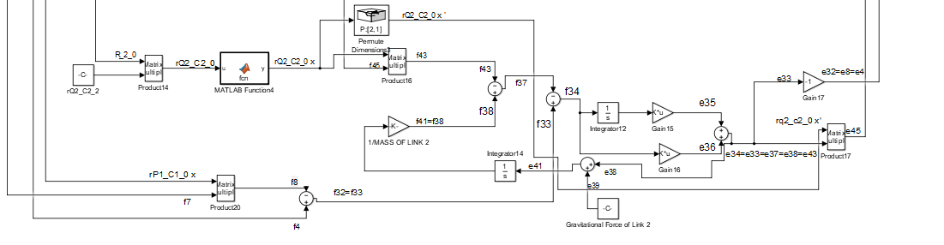
Block 2b- which represents translational motion of link 2

Slide 19
Ziegler nichols tuning method
The Ziegler- Nichols tuning method is a method of tuning a PID Controller. It is performed by setting the I and D gains to zero.
The Proportional gain, Kp is then increased from zero until it reaches the ultimate gain Ku, which is the largest gain at which the output of the control loop has stable and consistent oscillations.
Tu is the oscillation period.
Control Type | Kp | Kd
PD | 0.8* Ku | (Ku* Tu)/10

Slide 20
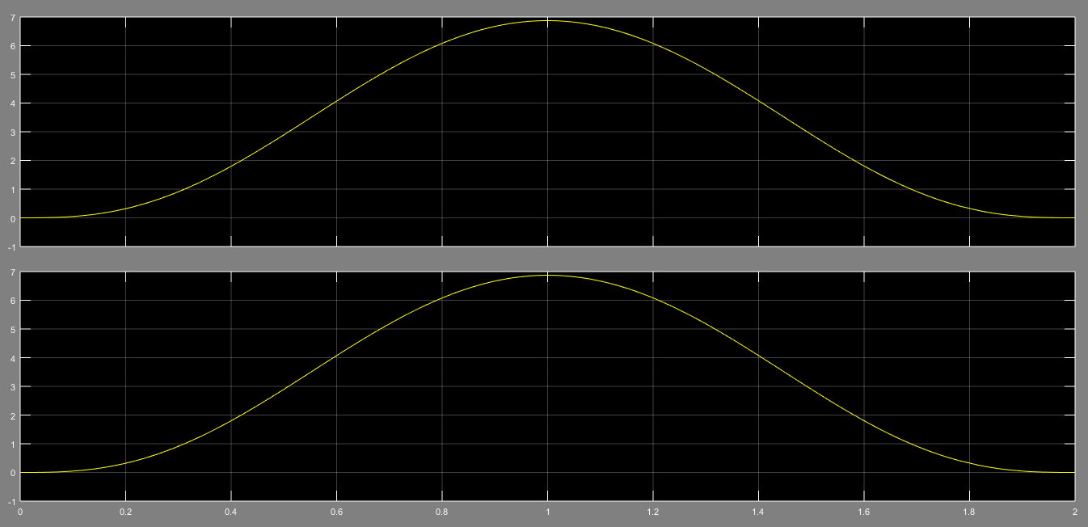
Desired and Actual Angular Velocity( f28 and f27) For 1st Link

Slide 21
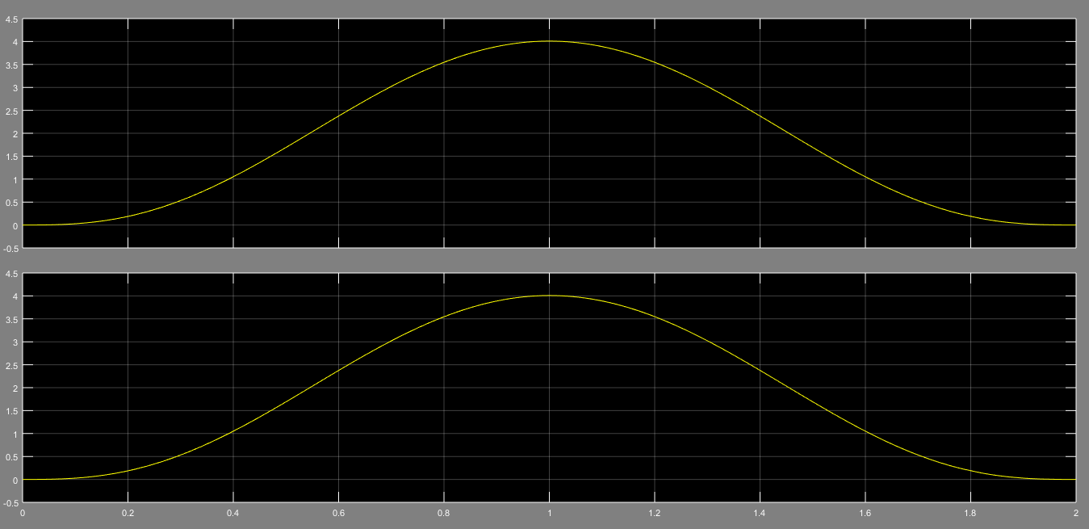
Desired and Actual Angular Velocity ( f62 and f61 ) for 2nd link

Slide 22
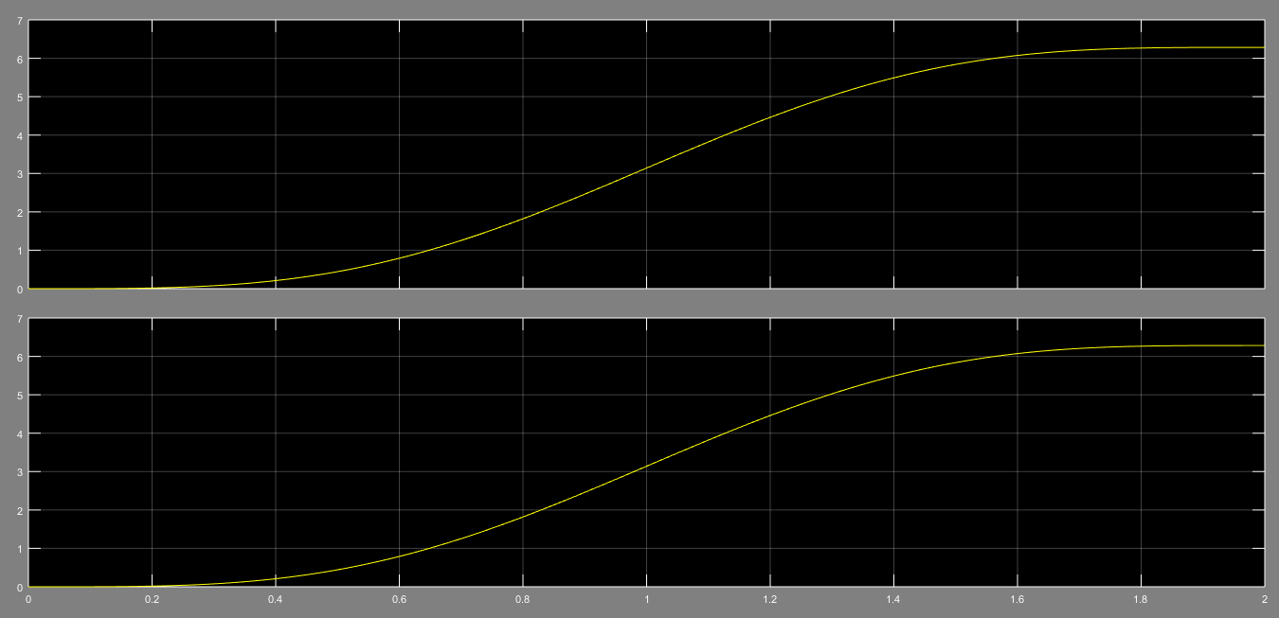
Desired and Actual Angular Position For 1st link Link

Slide 23
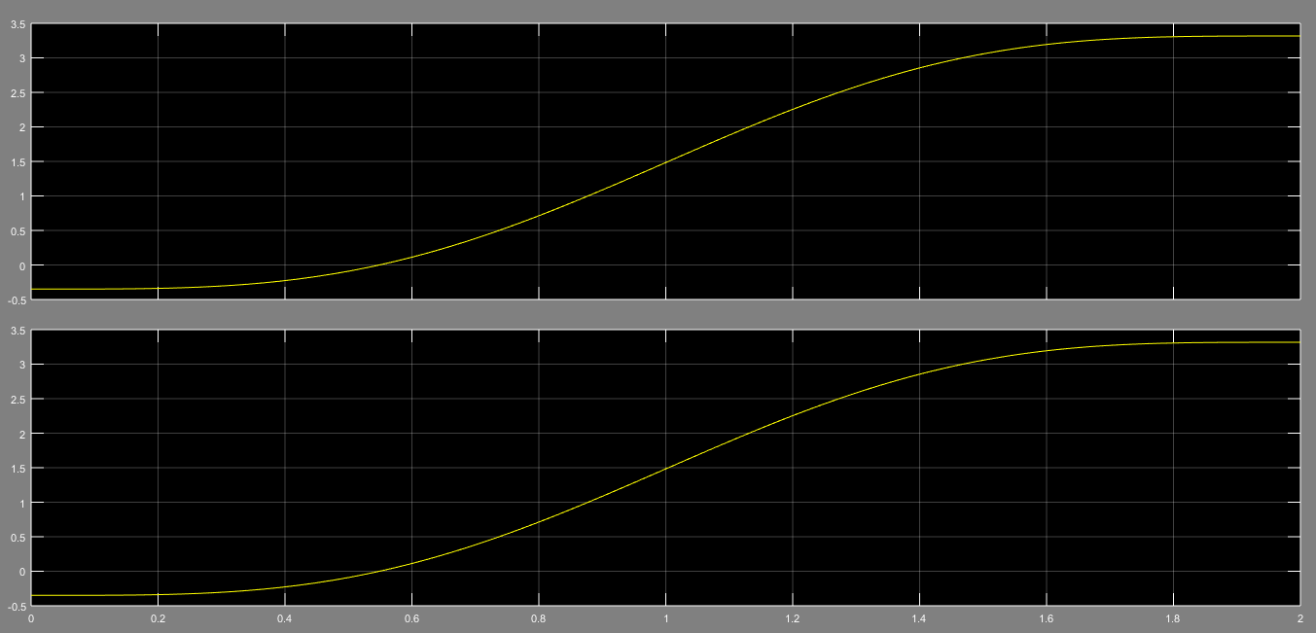
Desired and Actual Angular Position For 2nd Link
Desired angular position for 2nd link

Slide 24
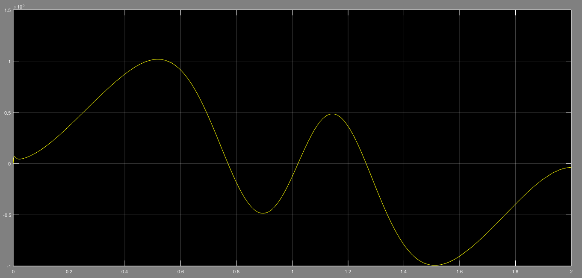
Effort produced at first joint in z direction( e27)

Slide 25
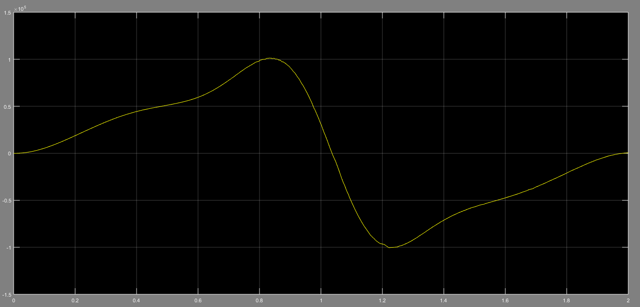
Effort produced at joint between two links in z direction( e61)

Slide 26
Conclusion
Such a Simulink model will be very helpful to assess the system performance whenever a component like motor is replaced with a different model during upgradation of system, or some system parameter like antenna load or tacking accuracy are changed or some advance controller(like LQG controller) is used in place of/in addition to PID controller to counter wind gust effects on tracking accuracy of the antenna.

Slide 27
References
John J. Craig, Introduction to Robotics: Mechanics and Control,Addison-Wesley,2005.
https://in.mathworks.com

